Slide 1
Introduction to Object-Oriented Programming (OOP)

Slide 2
Programming paradigms
1. Procedural Programming
Code as a sequence of step-by-step instructions/procedures (functions) that operate on data. No bundling of data and behavior.
Examples: C, Pascal, early BASIC
Core idea: "Do this, then this, then this."
C
int add(int a, int b) {
return a + b;
}
2. Object-Oriented Programming (OOP)
Data and behavior are bundled into objects. (Covered in your last question — classes, inheritance, polymorphism, encapsulation.)
Examples: Java, C++, Python, Ruby
Core idea: "Objects that have state and behavior."

Slide 3
Programming paradigms
3. Functional Programming
Computation is treated as evaluating mathematical functions. Avoids changing state or mutable data — emphasizes pure functions, immutability, and functions as first-class values.
Examples: Haskell, Lisp, Erlang; Python/JS support functional style
Core idea: "Same input always gives same output. No side effects."
python
# Functional style in Python
add = lambda a, b: a + b
squares = list(map(lambda x: x**2, [1, 2, 3]))

Slide 4
Programming paradigms
4. Logical Programming
Programs are written as a set of facts and rules. You state what is true, and the system figures out how to satisfy queries against those rules (uses inference/search, not explicit steps).
Examples: Prolog, Datalog
Core idea: "Here are the facts and rules — you figure out the answer."
prolog
parent(tom, bob).
parent(bob, ann).
grandparent(X, Y) :- parent(X, Z), parent(Z, Y).
% Query: grandparent(tom, ann). → true

Slide 5
Programming paradigms
5. Declarative Programming (logical & functional)
A broader umbrella — you describe what you want, not how to get it. Functional and logical programming are both subsets of declarative programming. SQL is the classic example.
Examples: SQL, HTML, regex, Prolog
Core idea: "Describe the result, not the steps."
sql
SELECT name FROM employees WHERE department = 'Finance’;
6. Imperative Programming (procedural & OOP)
The opposite umbrella to declarative — you explicitly tell the computer how to do something, step by step. Procedural and OOP are both subsets of imperative programming.

Slide 6
Four core pillars of OOP
1. Classes and Objects
A class is a blueprint. An object is an instance created from that blueprint.
python
class Car:
def __init__(self, make, model):
self.make = make
self.model = model
my_car = Car("Toyota", "Corolla") # my_car is an object (instance) of Car

Slide 7
Four core pillars of OOP
2. Encapsulation
Bundling data (attributes) and behavior (methods) together, and controlling access to them.
python
class BankAccount:
def __init__(self, balance):
self._balance = balance # underscore = "internal use" convention
def deposit(self, amount):
self._balance += amount
def get_balance(self):
return self._balance
Python doesn't have true private variables — _balance is a convention, __balance triggers name-mangling, but nothing is truly locked. The point is controlling how data gets modified, not just hiding it.

Slide 8
Four core pillars of OOP
3. Inheritance
A class can inherit attributes/methods from another class, avoiding duplicate code.
python
class Vehicle:
def __init__(self, wheels):
self.wheels = wheels
def describe(self):
return f"This vehicle has {self.wheels} wheels."
class Motorcycle(Vehicle):
def __init__(self):
super().__init__(wheels=2) # calls parent's __init__
m = Motorcycle()
print(m.describe()) # "This vehicle has 2 wheels."
Motorcycle is the child/subclass, Vehicle is the parent/superclass.

Slide 9
Four core pillars of OOP
4. Polymorphism
Different classes can be used through the same interface, each responding differently to the same method call.
python
class Dog:
def speak(self):
return "Woof"
class Cat:
def speak(self):
return "Meow"
for animal in [Dog(), Cat()]:
print(animal.speak()) # Woof, then Meow
Same method name (speak), different behavior depending on the object's class.

Slide 10
Four pillars of OOP
Abstraction
Hiding complex implementation details behind a simple interface. In Python this is often done with abstract base classes:
python
from abc import ABC, abstractmethod
class Shape(ABC):
@abstractmethod
def area(self):
pass
class Square(Shape):
def __init__(self, side):
self.side = side
def area(self):
return self.side ** 2
Shape can't be instantiated directly — it forces any subclass to implement area().

Slide 11
Attributes and methods

Slide 12
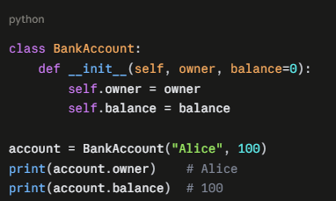
Attributes
An attribute in Python is a piece of data (or a function) that belongs to an object. You access it with dot notation: object.attribute.
Here, owner and balance are attributes of account. They were created in __init__ by assigning to self.owner and self.balance.

Slide 13
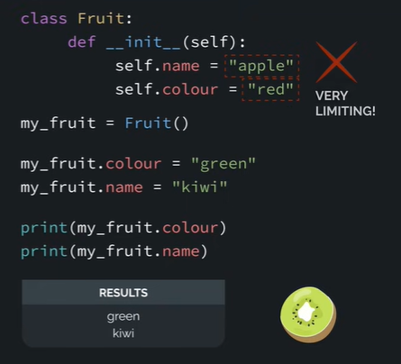
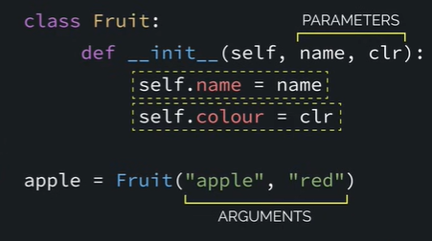
Attributes
This is limiting because we This option is better because we can
are stuck at apple and red change the name and colour as we need

Slide 14
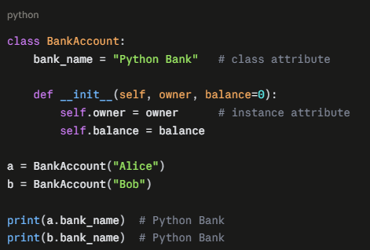
Class and instance attributes
Instance attributes
These belong to one specific object. Each object gets its own copy, so changing one doesn't affect the others.
Class attributes
These are defined directly in the class body, outside any method. They're shared by every instance.

Slide 15
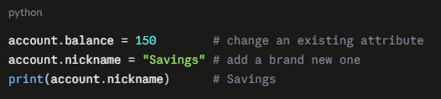
Reading, changing, and adding attributes

Slide 16
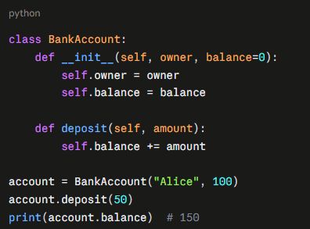
Methods
A method is a function that belongs to a class. You define it inside the class body, and you call it on an object with dot notation: object.method().
Here, deposit is a method. It uses self.balance to read and change the account's own data.
What self means in methods
Just like in __init__, self is the object the method is being called on. Python passes it automatically as the first argument. When you write account.deposit(50), Python effectively runs BankAccount.deposit(account, 50). That's why the definition has two parameters (self, amount) but you only pass one.

Slide 17
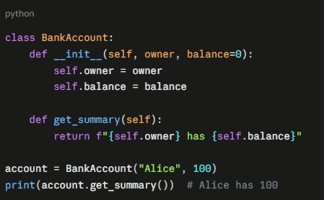
Methods that return values

Slide 18
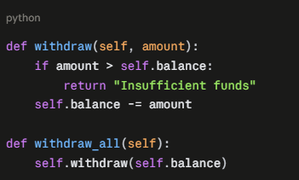
Methods that call other methods
Use self to call one method from another inside the same class:

Slide 19
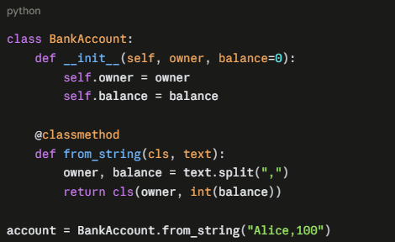
Three kinds of methods
Instance methods are the normal kind shown above. They take self and work with one specific object.
Class methods take the class itself (conventionally cls) instead of an instance. They're marked with @classmethod and are often used as alternative ways to create objects:

Slide 20
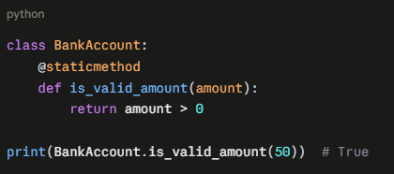
Three kinds of methods
Static methods take neither self nor cls. They're marked with @staticmethod and are just regular functions that live in the class because they're related to it:

